Slide 1
Student Features and Grades Analysis
Aleksandr Savenko – Thinkful Data Immersion Cohort 8
Notes:
Hello! My name is Aleksandr Savenko and I’m a student at Thinkful Data Immersion Cohort 8. This is my final project: students features and grades analysis.

Slide 2
Introduction
Overview of Demographic Data about Students Features
01
Assigned Goals and Research Questions
02
Hypothesis Testing Method (Null and Alternative)
Notes:
Today I will speak about student's data analysis and sharing insights that I got. The data were obtained in a survey of students’ math and Portuguese language courses in secondary school. It contains a lot of interesting social, gender, and study information about students. The main goals were researching this data for finding reasons to say what variables are connected or transfer to grades. The main exploration methods were working with python libraries: pandas, stats, seaborn, matplotlib.pyplot. I used different investigation methods and one of the most important was hypothesis testing. I will explain it in the next slides.

Slide 3
Project Overview
Two student demographic data sets
400 rows related to Math test grades
650 rows related to Portuguese test grades
33 columns consisting of variables such as sex, age, family size, internet access, weekly study time, alcohol consumption, absences, and test grades
Why I chose this data set
Interested in student data and evolving my skills
Show if various variables affect student test scores
Give value for future educational research
Notes:
Let’s dive little more into data. This data has 33 columns and 2 datasets to investigate. One of them is demographic data about students (396 rows) with their math test grades and the second one is data about students (650 rows) with their Portuguese test grades. It consists of different variables such as sex, age, family size, parents’ education, weekly study time, extra paid classes, internet access, alcohol consumption, absences, and grades for tests (and more). I’m interested in researching this data for finding reasons to say what variables are connected or transfer to grades: Does family size or family relationships affect grades? Does alcohol consumption affect grades? Do special paid courses affect grades? And other questions. Also, results can help to build a way for new research.

Slide 4
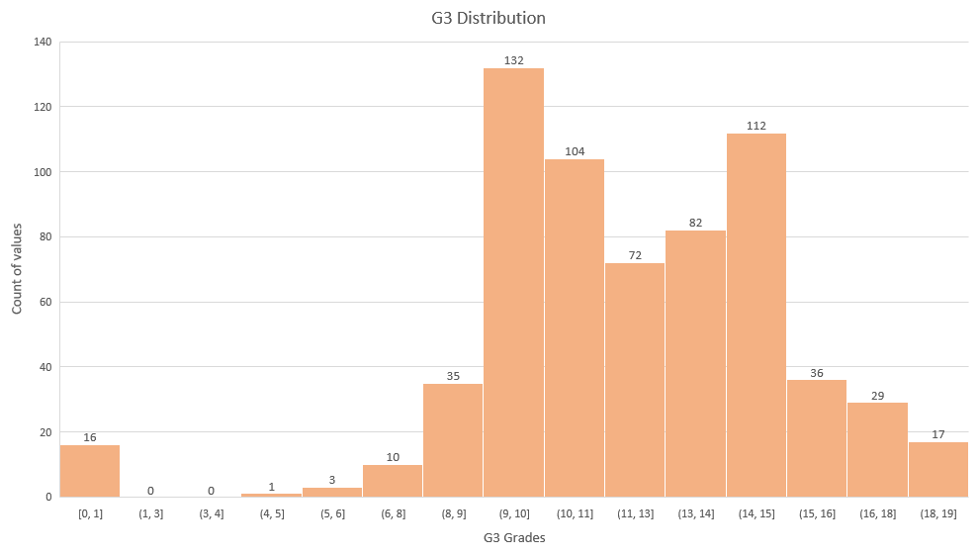
Data Insights
Median:
12
Minimum:
0
Maximum: 19
Count of data:
649
Notes:
Let’s start from basic but very important insights. Data has 33 columns and 3 of them are G1, G2, AND G3. There are first period grade, second grade and final grade. I choose only last one for making it easy to understand and it’s the final one. Here you can see chart distribution with bins. The median or middle number is 12 but you can see that the most frequent ones are number 9 and 10 and 14 and 15. Maximum value for test is 19.

Slide 5
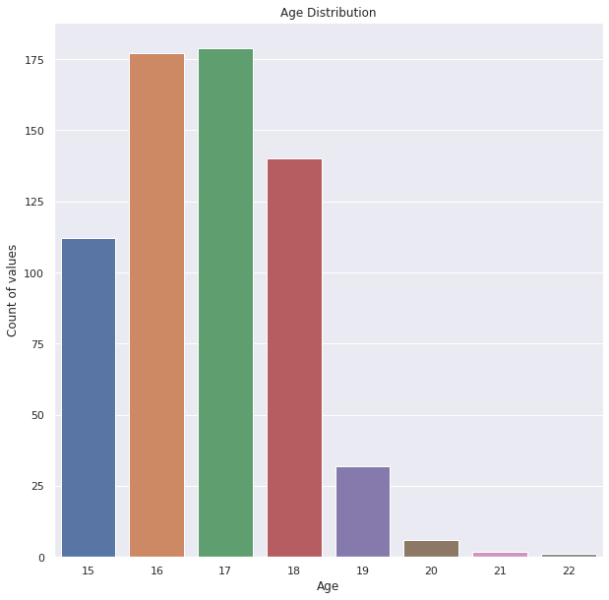
Data Insights
Age values
Mean: 16.7
Minimum:15
Maximum: 22
25%: 16
50%: 17
75%: 18
Count: 649
Notes:
Second basic and important distribution is student's age. Mean is 16.7. Max is 15 and minimum is 22. 25% starts from 16 and 75% of data starts from 18.

Slide 6
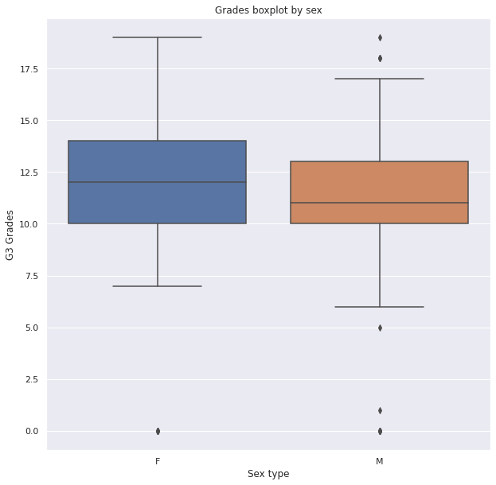
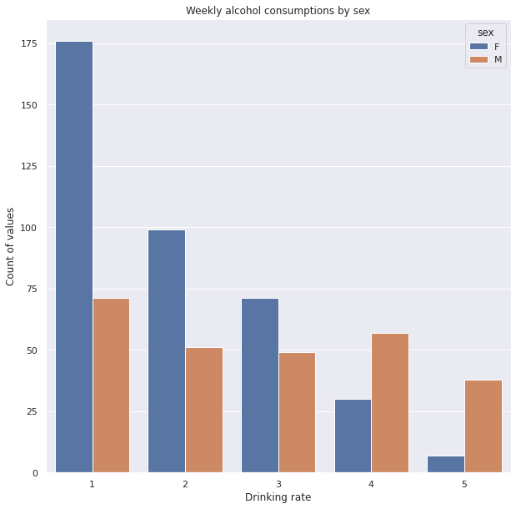
Data Insights
The majority of women have low alcohol consumption per week. However, the majority of men have higher rate.
Overall women have higher grades with p-value=0.0009 and mean: 12.2 vs 11.4
Notes:
Let’s speak about insights from hypotheses testing. I need to explain what hypotheses are here. For example, we take data with 2 parameters but with the same variable for comparison. One of the most basic hypothesis was difference between women and men grades. I made 2 ranges by filtering sex in Python and made a T-test. Null hypothesis is that its no difference or same means. Alternative hypothesis is that it’s a different means. We have a p-value which is one of the most important numbers because it shows the percentage of answers that helps us to choose the answer. It must be less than 5 percent (alpha value) to confirm the difference because the other 95% values will be in a normal distribution. It’s a range with minimum outliers. So, its one of the confirmed hypothesis that women are better in tests and boxplot shows it. You can see middle line and its mean value. Other lines are 25 and 75 quartiles. Women are better in Portuguese test and have higher mean. More than that, On the second chart you can see that men consume more alcohol per week and women drink less.

Slide 7

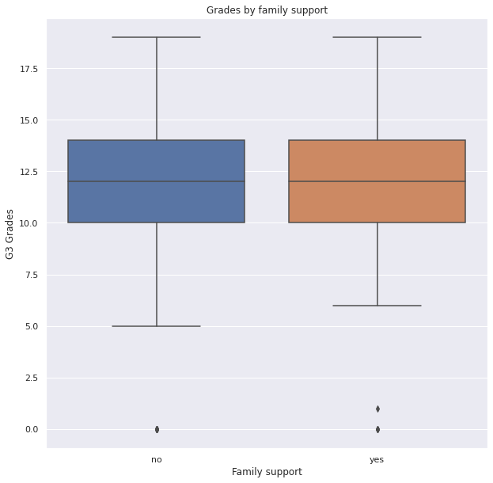
Failed hypotheses
Failed to reject the null paid hypothesis with p-value=0.16 and mean: 11.9 vs 11.2
Failed to reject the null family hypothesis with p-value=0.13 and mean: 11.6 vs 12.05
Notes:
I included some failed hypotheses. Students who attend paid courses didn’t show higher grades. Also, family support didn’t show some different means in grades. It was proved with t test and p-value bigger than alpha. Which fails to reject the null.

Slide 8
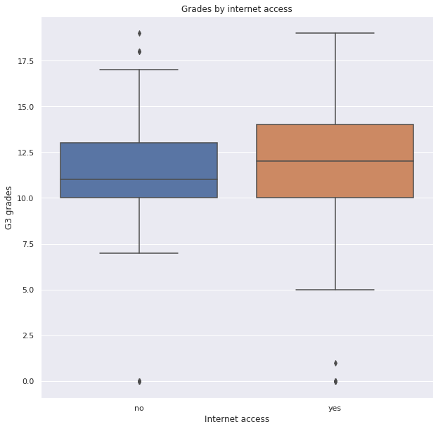

Demographic hypotheses
Reject the null internet access hypothesis with p-value: 0.0001 and mean: 11.02 vs 12.17
Reject the null area type hypothesis with
p-value: 1.76-05 and mean: 12.2 vs 11.08
Notes:
I made different topics for different hypotheses. Let’s start with demographic once. Internet access hypothesis shows that availability to it helps students to achieve better results. Highest mean is 12.2 rounded. Area type also affects grades. Students from urban area have better results and their mean is 12.2

Slide 9
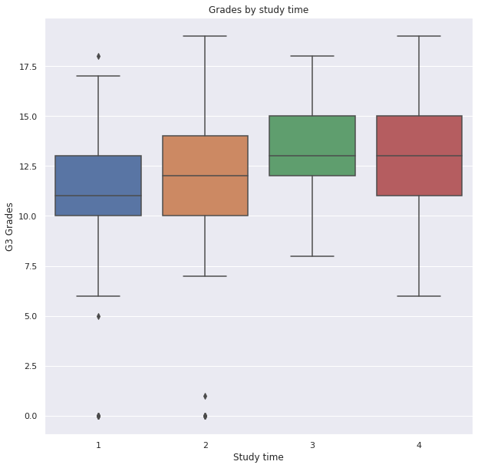
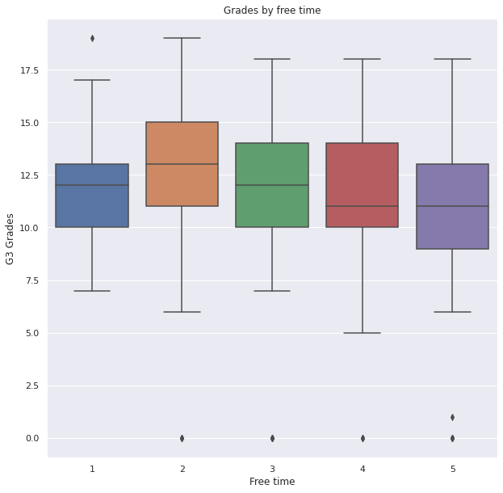
Time hypotheses
Reject the null free time hypothesis with
p-value: 0.003 and mean: 12.19 vs 11.43
Reject the null study time hypothesis with
p-value: 2.9-07 and mean: 11.58 vs 13.18
Notes:
Next topic for investigation is time hypotheses. Students who spend more time by studying have mean equal to 13.18 And students who spend less free time have also better results. It was proved by T-test by making ranges and filtering in Python. You can see boxplots with means and time rates that students wrote in a survey.

Slide 10
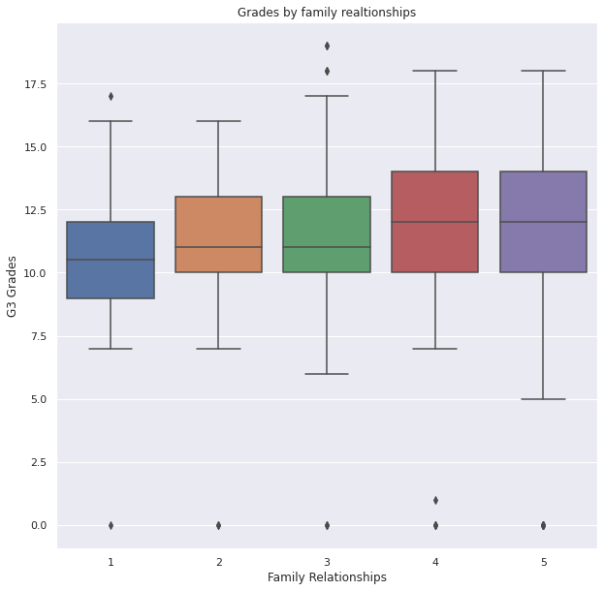
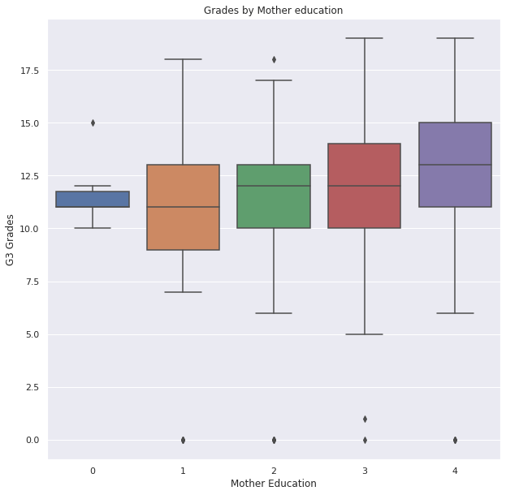
Family hypotheses
Reject the null family relationships hypothesis with p-value: 0.009 and mean: 11.31 vs 12.08
Reject the null mother education hypothesis with p-value: 4.6-07 and mean:11.29 vs 12.56
Notes:
Final topic is family parameters connected with grades. It’s also rates given by students. One of the most interesting results that good family relationships affect better grades. Also, both parents' education affect student success. Mother and Father higher education test showed that students achieve better results.

Slide 11
Final conclusions
Demographic decisions (area, sex, school, internet)
Time value (study/free, going out, romantic relationships, alcohol consumption)
Family value (relationships, support, living status, size, education)
Notes:
Let's speak about final decisions and recommendations. I will say discuss more insights from my analysis. Some of them was not in this presentation
As we can see, women are better in test succeeding. It's a good step for making another research. Urban area students are better in tests than Rural. We can't force people to change their place of living, but we can try to understand why it's important. Students of one school have better results than other one. And internet access also shows us result.
Next one is time value. Bigger study time, lower free time, and less time for going out(3 different hypothesis) follow better results. Lack of romantic relationships lead to higher mean among students. It's good to know but it's also a good step to compare happiness parameter and existence of romantic relationships. Students with less consumption have bigger test mean than others.
Finally, we can speak about students and their family. Students with better family relationships and higher parents' education are better in completing the test. But family size, parent relationship status(apart or not), and family support didn't show results to say that it led to higher grades. It can lead to some effects but its not enough for statistical difference.
Let's provide access to internet and give them time to study more. After these results, we can say that parents should have good relationships with their children. One of the most important insight here is that your environment can make an effect on you like urban area or your school or access to basic needs.
Maybe it seems obvious but it’s something that you need to know and sometimes it’s not too hard to start help students. The final results can be helpful for schools or the educational system. Results can show how to increase academic performance and how to work with different students.

Slide 12

Thank you for your attention!
Notes:
Thank you for your attention.

